Slide 1
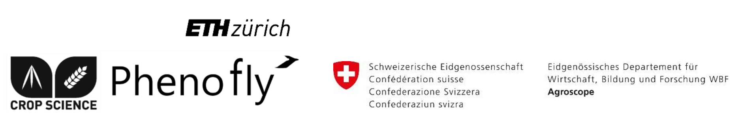
Flower Mapping in Grasslands with Drones and Deep Learning
Johannes Gallmann

Slide 2
Outline
Introduction / Motivation
Method
Results
Discussion / Questions

Slide 3
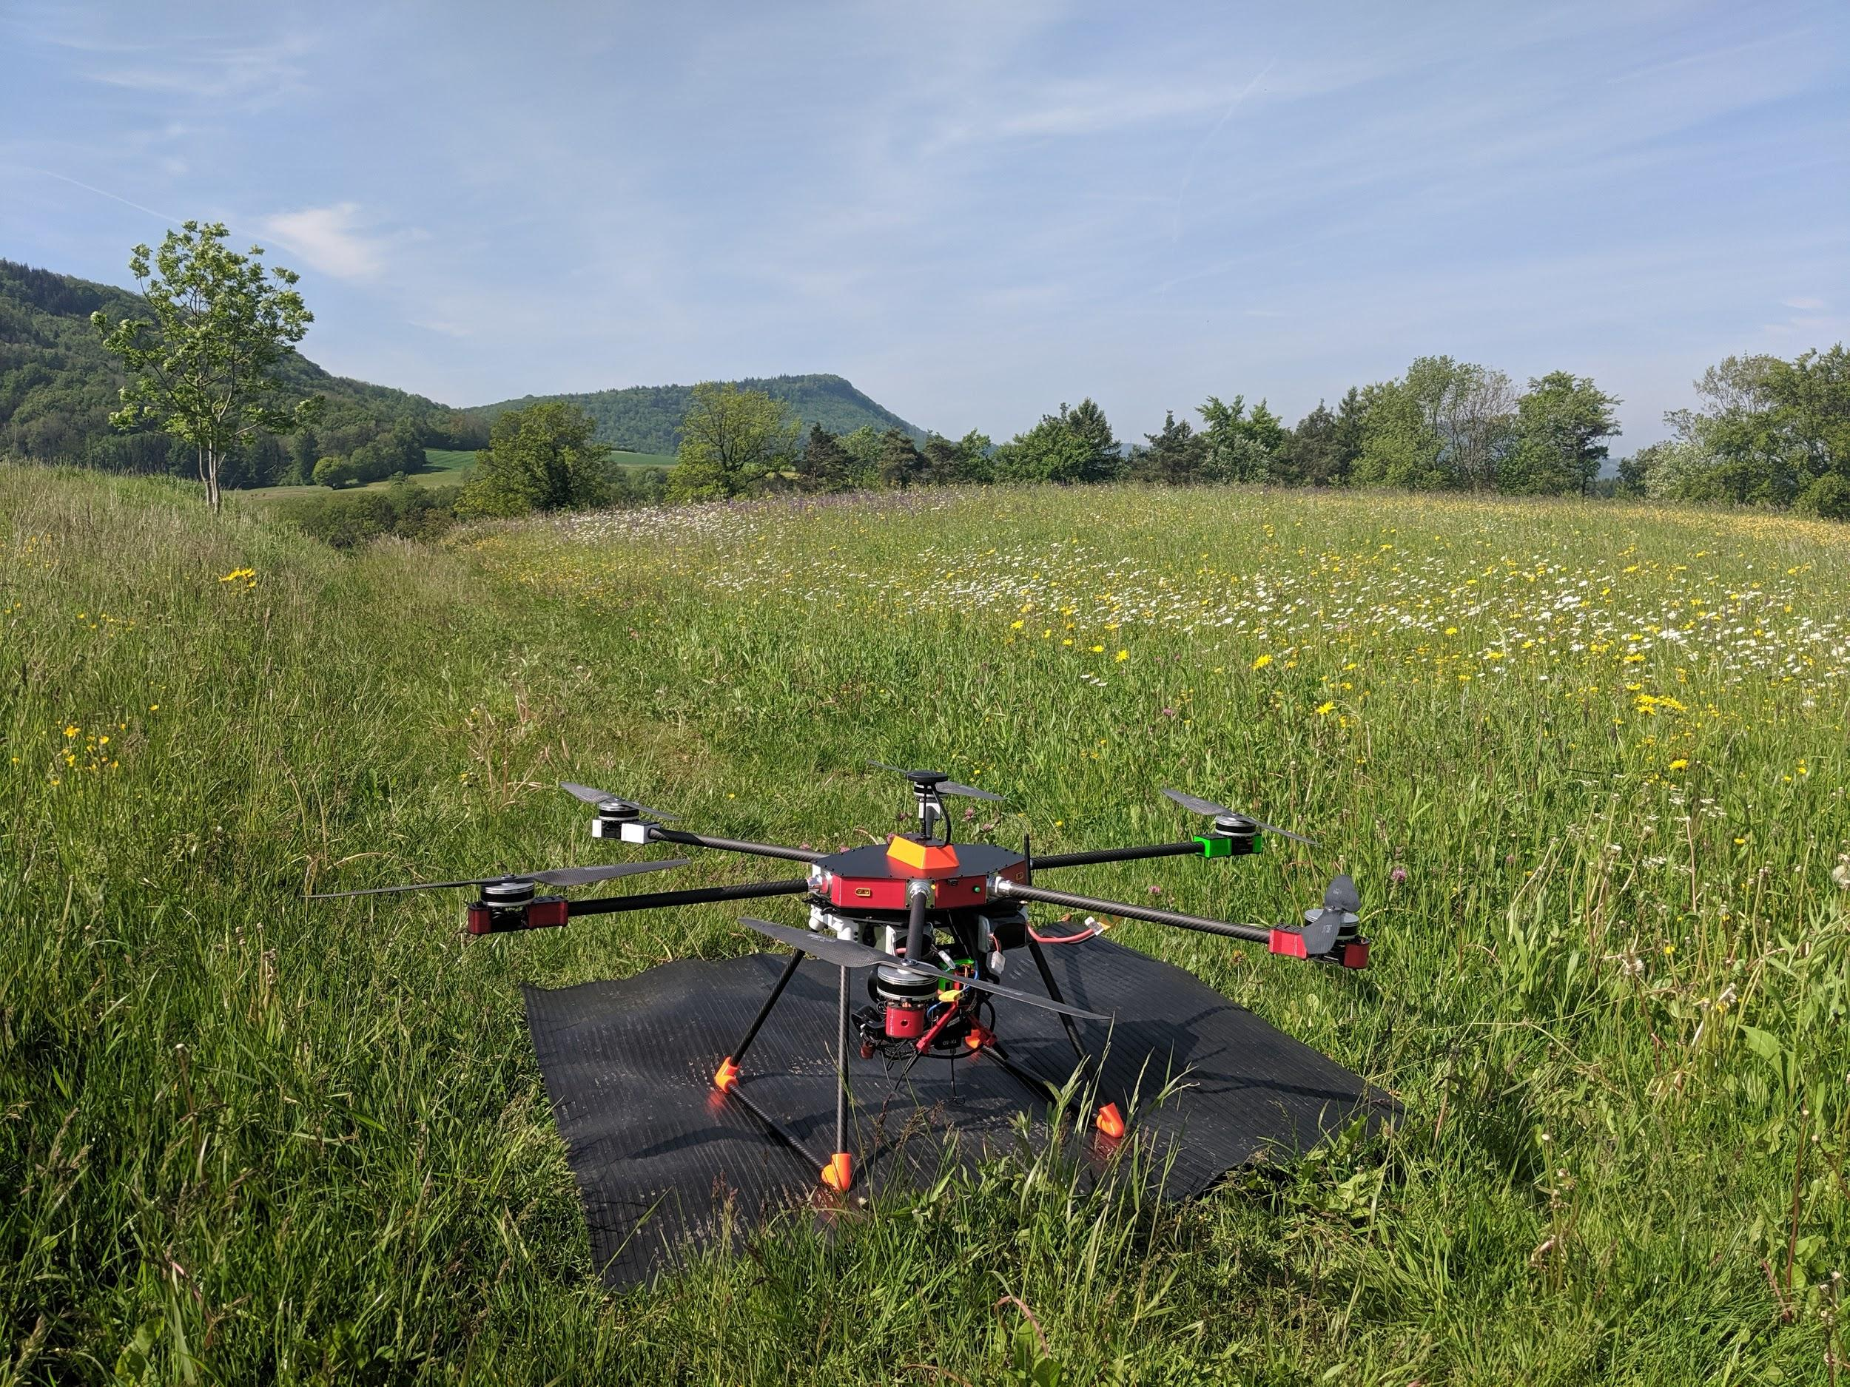
What is the motivation?
leucanthemum vulgare: 443
ranunculus bulbosus: 388
salvia pratensis: 120
lotus corniculatus: 160
trifolium pratense: 47
anthyllis vulneraria: 311
carum carvi: 62
Notes:
What is the thesis actually about? The thesis is about determining the flower abundance within a field in an automated manner.
But what is this information needed for?

Slide 4
What is this information needed for?
Information is needed for:
Studies about Biodiversity
Studies about Bees
Broad range of other imaginable use cases
Notes:
The thesis is carried out in collaboration with Agroscope. They are carrying out some extensive studies about bees and bio diversity in Switzerland. For these studies this information is very important. So it would be great if one could obtain this information by simply flying a drone across the field. Other than that, a broad range of other use cases are imaginable. I will mention a few in the discussion at the end of the presentation.

Slide 5
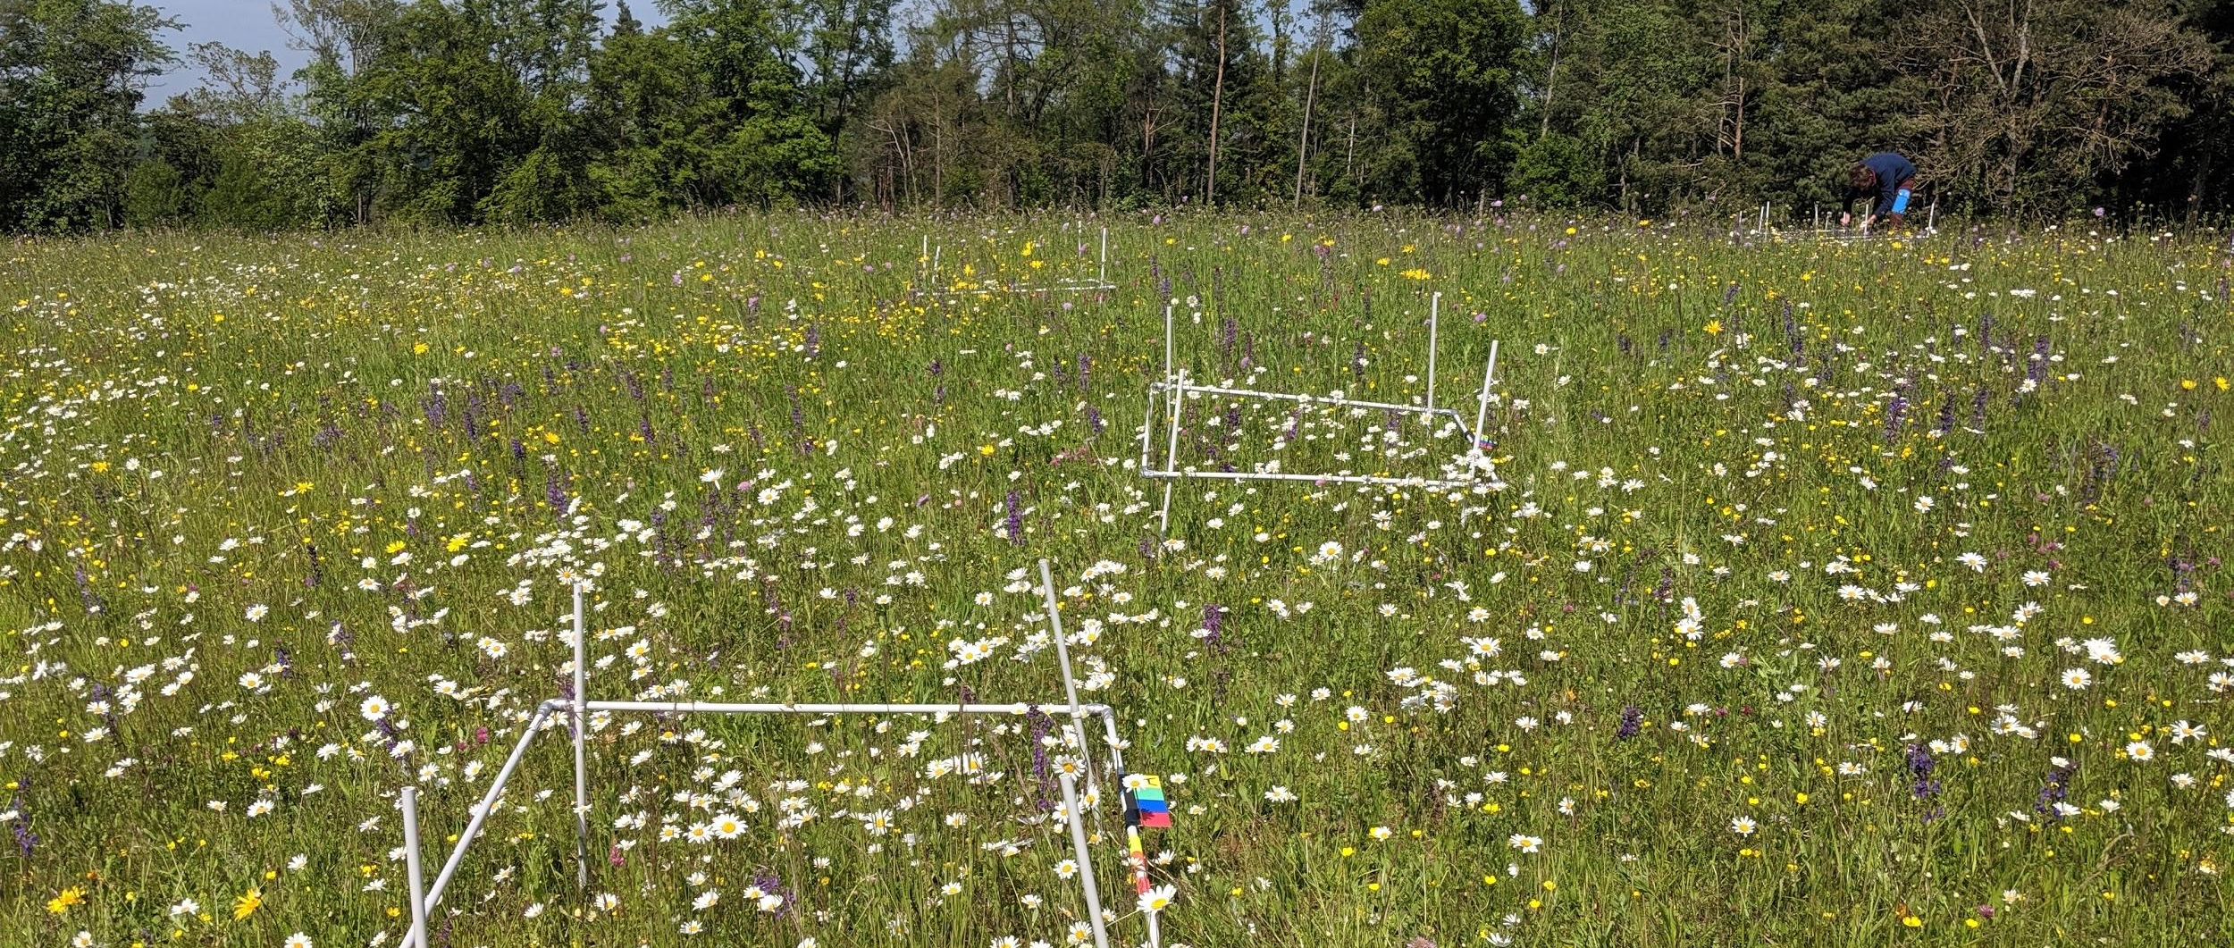
How is this information obtained traditionally?
Notes:
So how is this information about the flower abundance obtained today? Today, these squares are placed in the field in some representative places. Then the flowers are counted by hand inside each such square and the numbers are extrapolated to the whole field. If the positions of the squares are well chosen, this gives a good estimate of the flower population in the whole field. However this work is very tedious! And I can speak from expierience. So it would be great if this process could be automated.

Slide 6
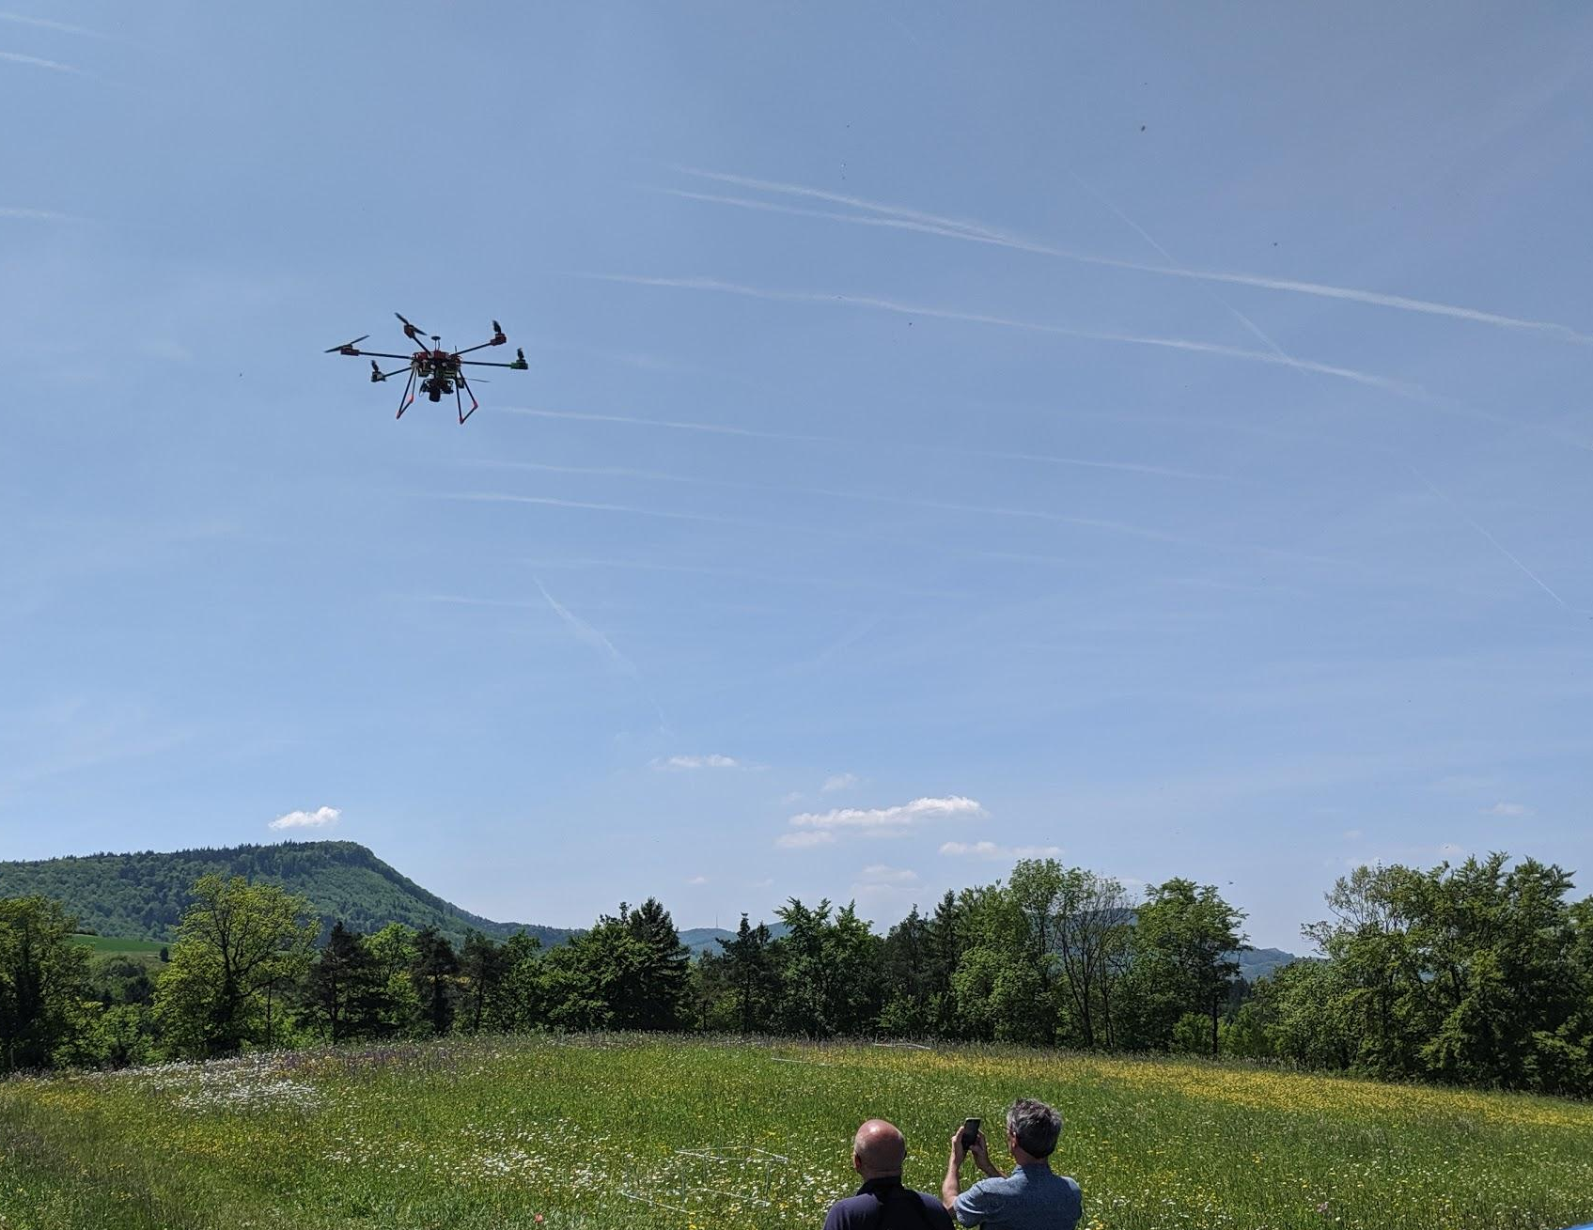
What is the goal of this thesis?
leucanthemum vulgare: 443
ranunculus bulbosus: 388
salvia pratensis: 120
lotus corniculatus: 160
trifolium pratense: 47
anthyllis vulneraria: 311
carum carvi: 62
Notes:
And that is the goal of the thesis. It would be great if we could just fly over the field with a drone that takes ultra high resolution images and from these images predict the number of flowers of each species.

Slide 7
Method
Notes:
So how did we try to do this? We did it using a deep neural network approach. One characteristic of deep neural networks is that they need a lot of training data. Therefore, the first task of the thisis was to collect training data. Then, a machine learning model was trained and tuned such that in the end we are able to make predictions using the trained network. I will now talk about the method in a bit more detail.

Slide 8
Method
Collect training data
Train and tune a machine learning model
Evaluate the model’s performance
Make predictions using trained model
Notes:
So how did we try to do this? We did it using a deep neural network approach. One characteristic of deep neural networks is that they need a lot of training data. Therefore, the first task of the thisis was to collect training data. Then, a machine learning model was trained and tuned such that in the end we are able to make predictions using the trained network. I will now talk about the method in a bit more detail.

Slide 9
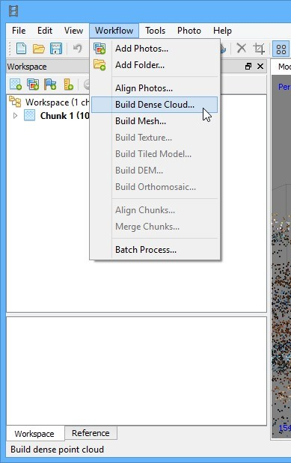
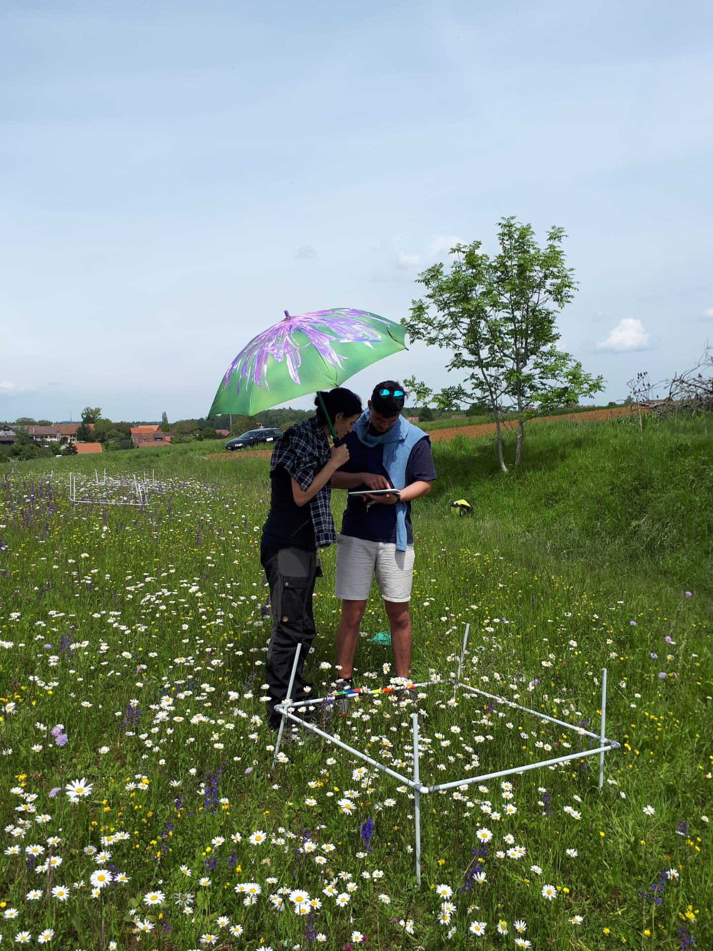
Method: Collect Training Data
1.
2.
3.
Notes:
To collect the training data three main steps are necessary. Firstly of course we need to fly the drone across the field and take the images. To do so, a pre planned route is loaded onto the drone and then the drone flies more or less automatically along this route and takes the images from the air. The second step is to take these single images and stitch them together with a program called agisoft. With this agisoft software a single huge image of the whole area of interest is created from all these single images taken with the drone. This big image is then loaded onto a tablet on which the flowers are annotated by hand. For this step I have programmed a small android tablet app which I will demonstrate in a short video.

Slide 10
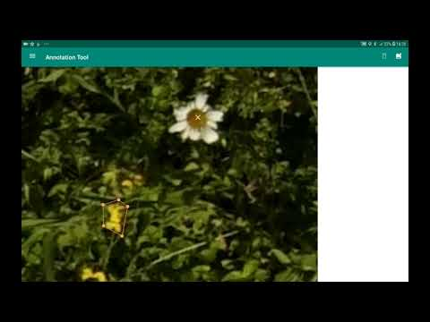
Notes:
Describe the app…
The advantage of having an app to make annotations on is that one can directly compare the flowers in the image to the flowers in the field. In some cases it is very difficult to determine the species from the image alone so this approach makes sure that the number of false annotations is minimized.

Slide 11
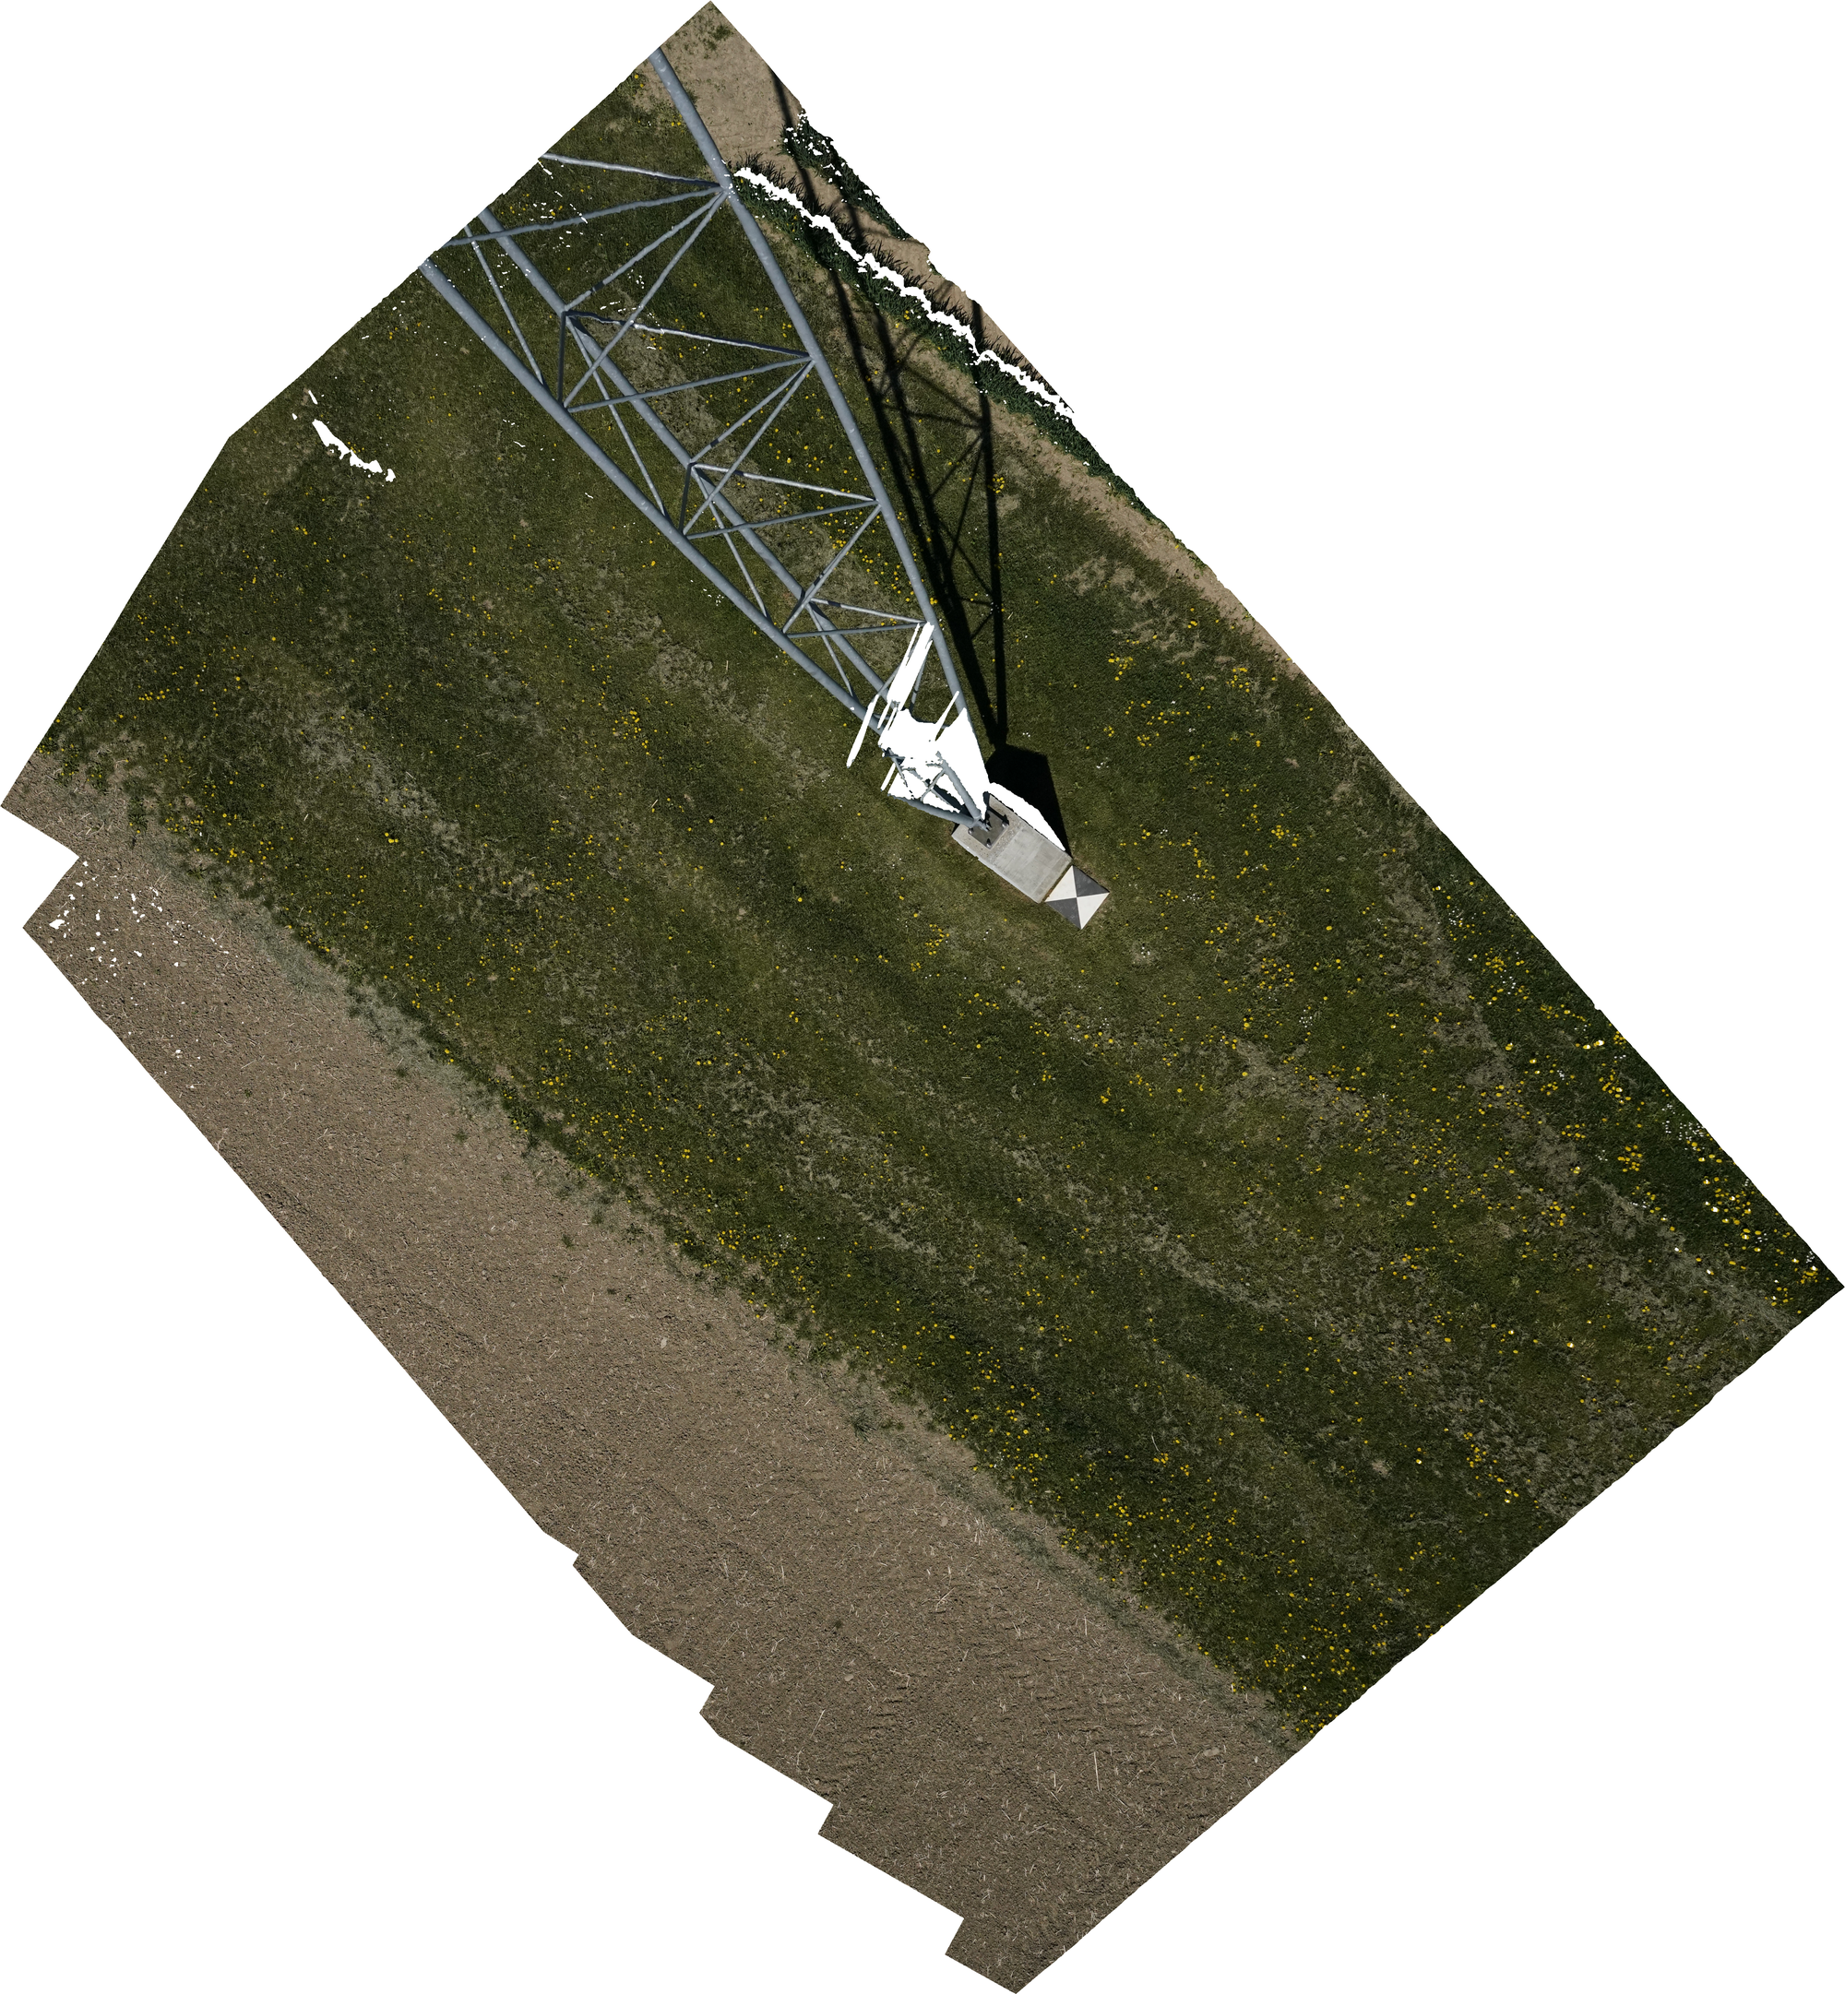
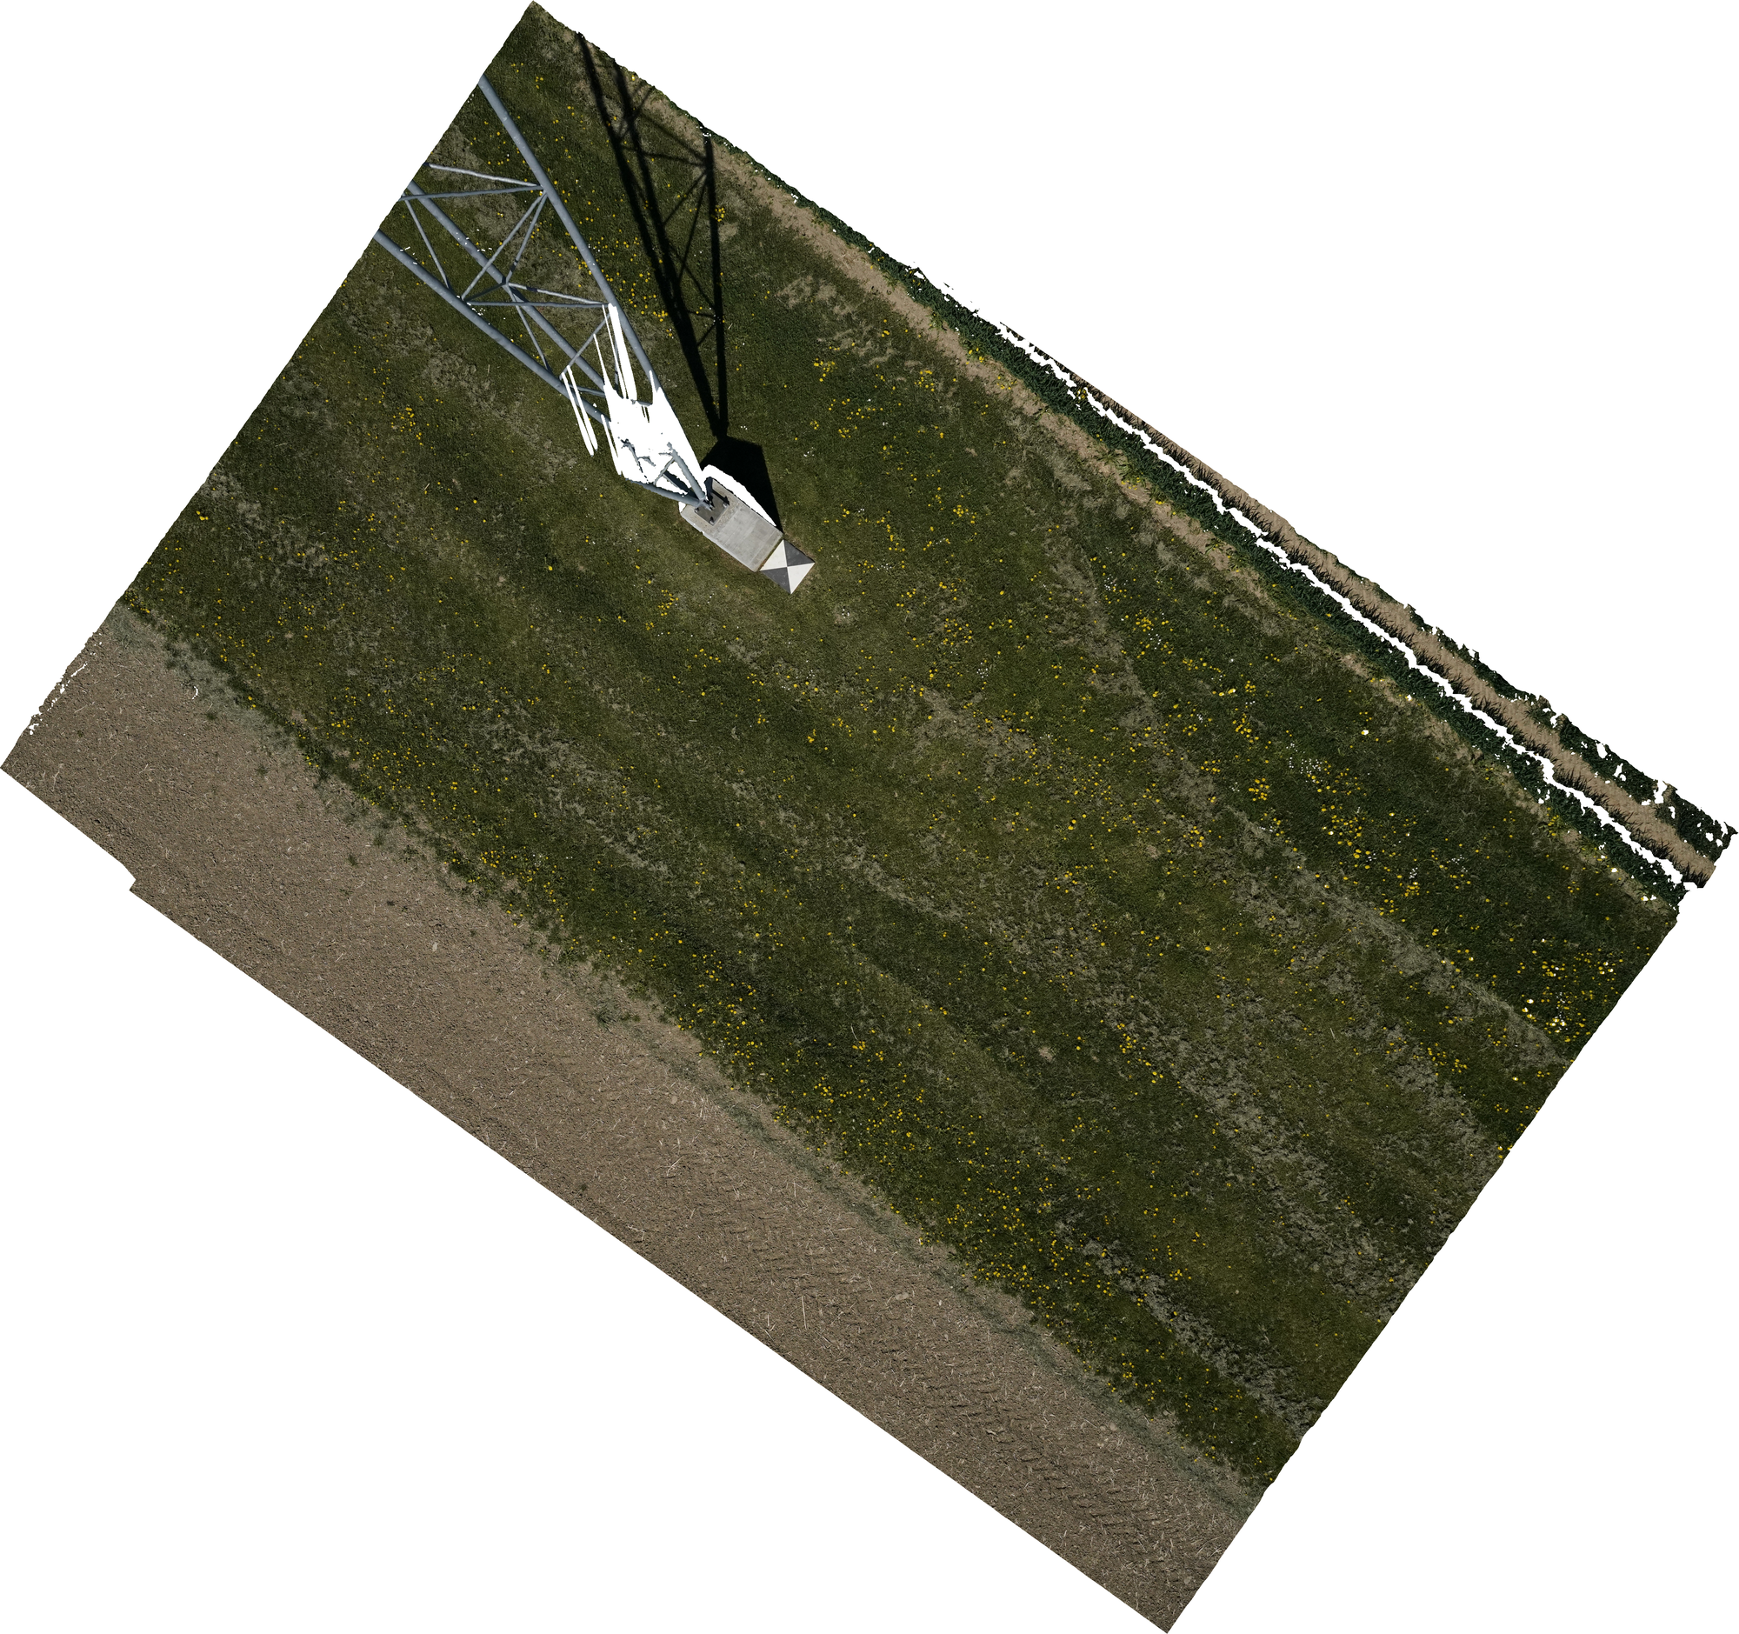
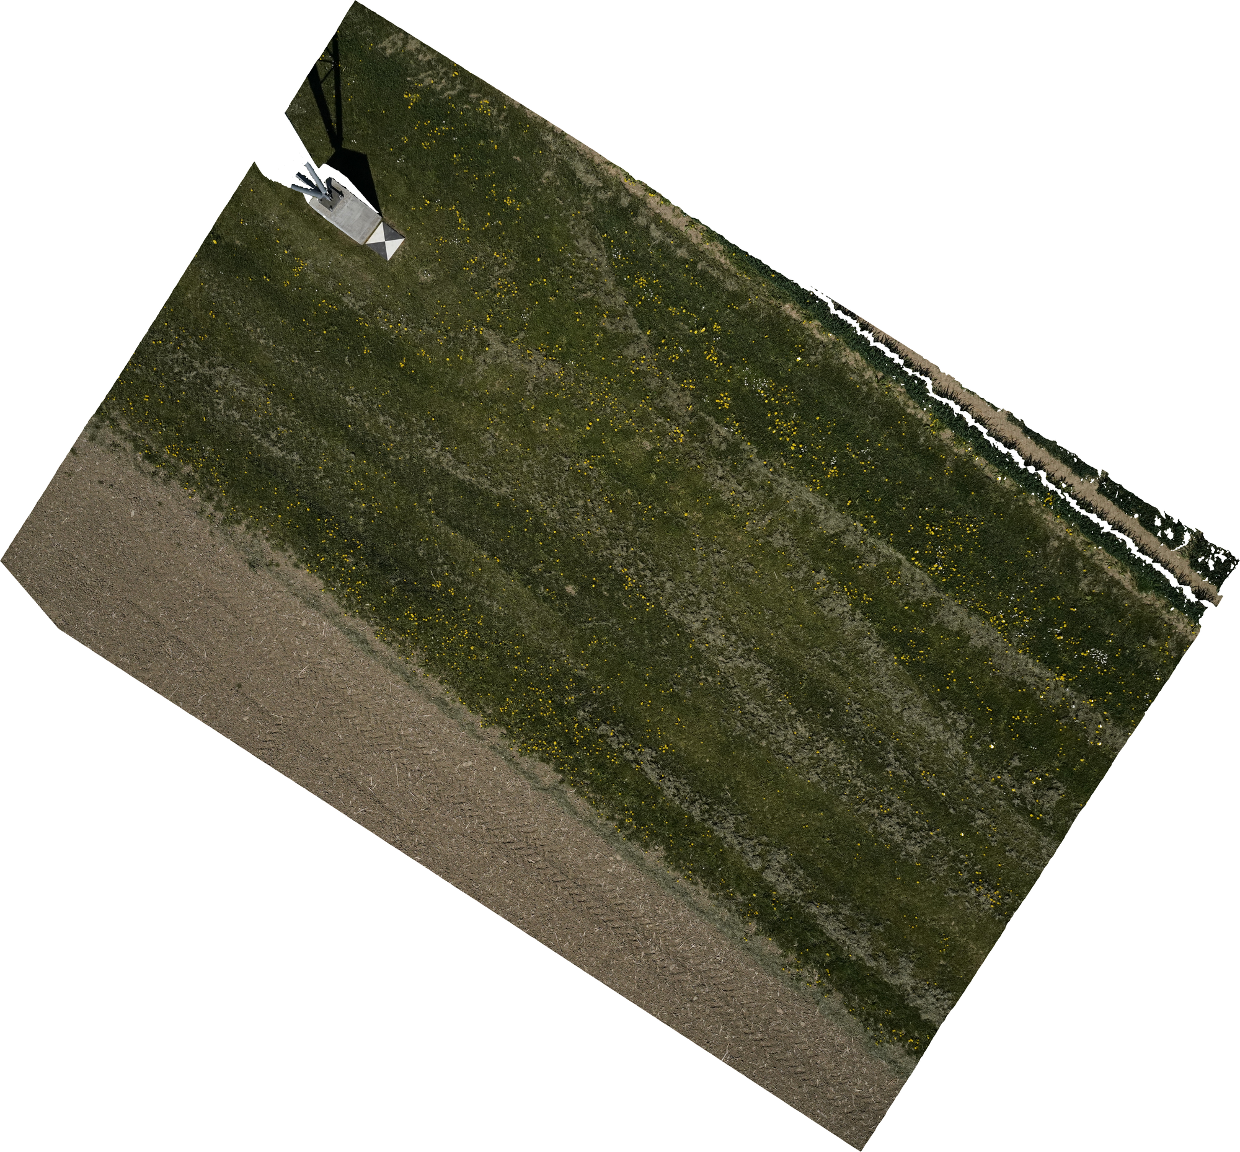
Method: Overlapping Images
Notes:
An additional question of the thesis is: Does the additional information from overlapping images help. So the drones take highly overlapping images such that each point in the field should be visible on 5 images. So I will evaluate if this additional information helps to improve the performance.

Slide 12
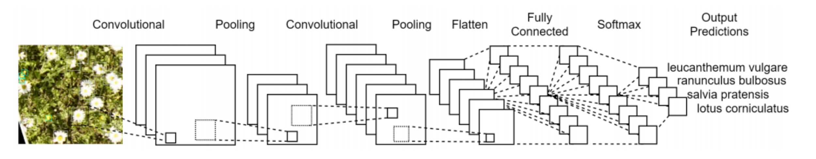
Method: Train a Machine Learning Model
Diagram created with draw.io
Notes:
Once a lot of training data is available, the second big step of the thesis is to take this annotation data and train a machine learning model. We use a deep convolutional neural network for this task. There has been great improvement in the performance of such networks for the task of object detection in the past few years. A deep convolutional network is basically a huge network with many layers (therefore it is called deep). If an image is fed to this network it applies thousands of filters to all regions of the image and tries to find the individual flowers with help of the combination of these filters.
To train such a network we have to feed it with the gathered annotation data. Concretely, the drone images together with the positions of all flowers.

Slide 13
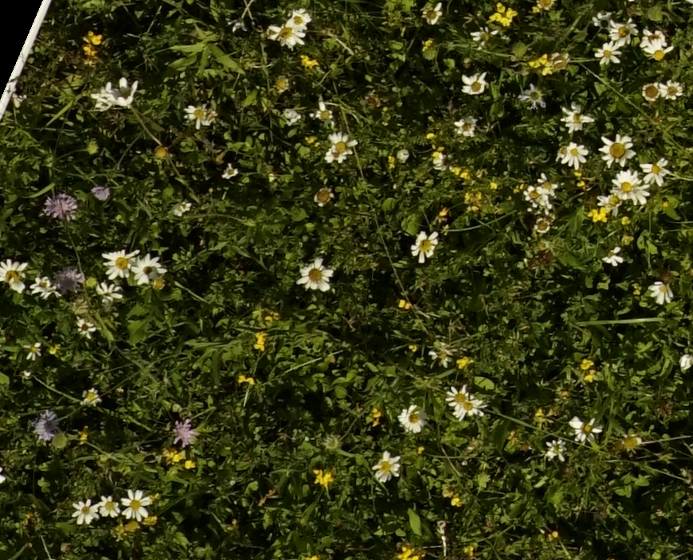
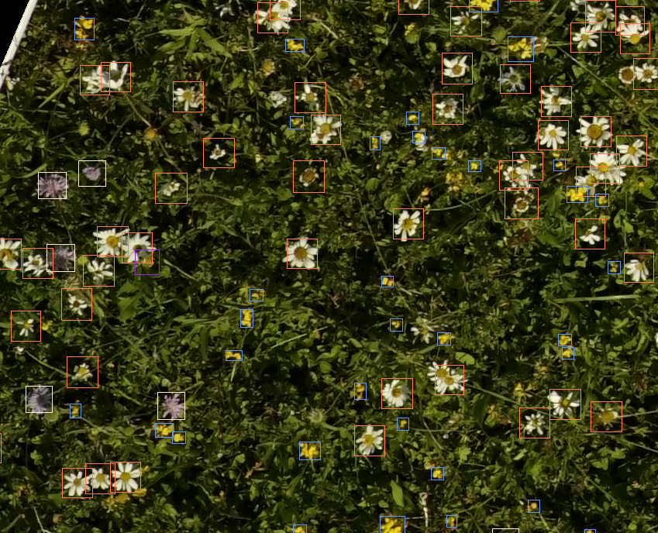
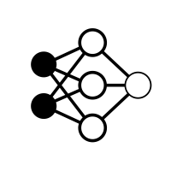
Method: Making Predictions using Trained Network
Tile 1
Tile 2
Tile 3
Tile 1
Tile 2
Tile 3
Tile 4
Tile 5
Tile 6
Tile 4
Tile 5
Tile 6
Notes:
Once such a network is trained, we can use it to make predictions on unseen images.

Slide 14
Method: Making Predictions using Trained Network
Tile 1
Tile 2
Tile 3
Tile 1
Tile 2
Tile 3
Tile 4
Tile 5
Tile 6
Tile 4
Tile 5
Tile 6
Notes:
Once such a network is trained, we can use it to make predictions on unseen images.

Slide 15
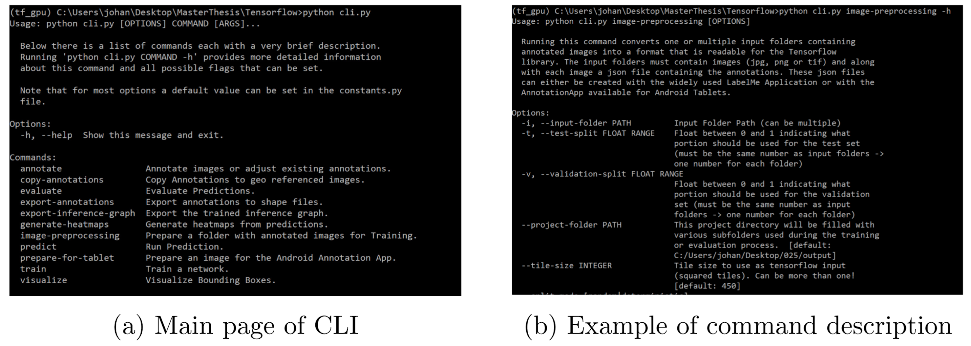
Method: Reusable Command Line Interface

Slide 16

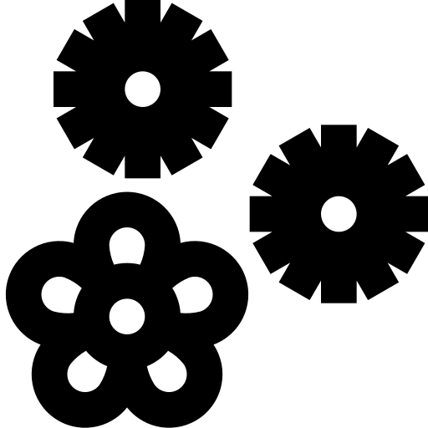

Results: Error Prone Manual Counting
Leucanthemum vulgare 724 960 +33 %
Knautia arvensis 371 471 +27 %
Ranunculus 431 474 +10 %
Onobrychis viciifolia 483 105 -78 %
Notes:
As a first evaluation I have compared the manually counted flowers to the annotations made on the tablet. Since we have counted the exact same regions as we have annotated on the tablet, these numbers are directly comparable. One would expect that on the tablet equally many or less flowers are counted. However the evaluations have shown that for many flowers actually less flowers are counted by hand. This leads to the conclusion that the manual countings are error prone, which is understandable in cases of high flower density and possibly wind that is moving the flowers. The advantage of making annotations on a tablet is that flowers are marked. Since this means that a very high portion of flowers is visible on the aerial images, this is a big motivation for the thesis because if a reliable detection model can be found, the accuracy of the flower abundance can be improved.
What you can also see on this slide is that for some flower the just made statement is not true. For example the onobrychis flower is hardly visible on the aerial images and therefore the results are not satisfying. You will also see this in subsequent slides.

Slide 17
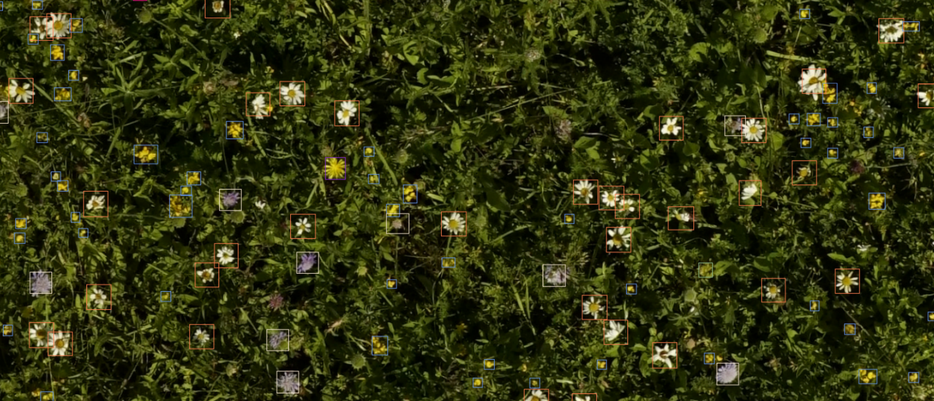
Results

Slide 18
Results: Precision and Recall
Precision Recall
Leucanthemum vulgare 97 % 89 %
Knautia arvensis 90 % 94 %
Lotus corniculatus 87 % 86 %
Onobrychis viciifolia 77.6 % 47 %
Overall 87 % 84 %
Notes:
Lets get back to the evaluation of the deep learning model performance. Taking the tablet annotations as ground truth, an overall (weighted mean) precision of 87 % and an overall recall of 84 % is achieved. Again there are well performing flowers and flowers that are not detected with satisfying accuracy. The main reasons for the non well performing flowers are lack of training data, the flowers being too small to be distinguishable or flowers which are difficult to keep apart from background.

Slide 19
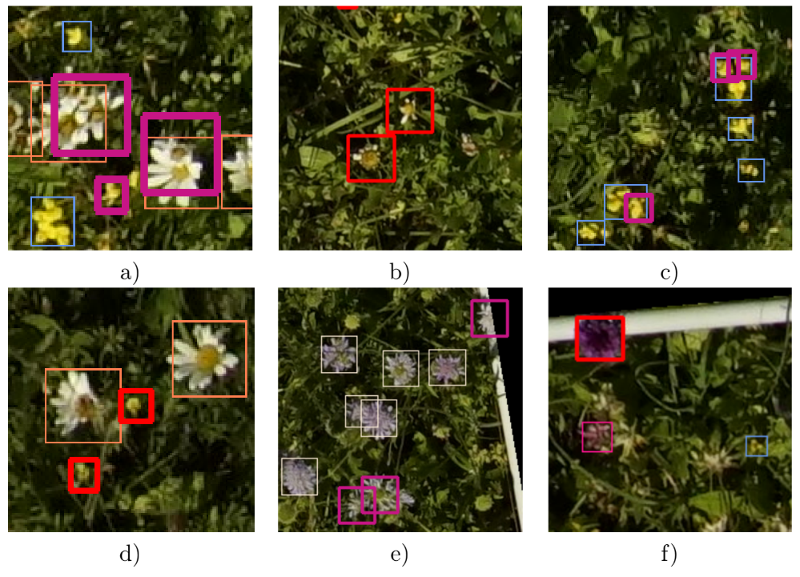
Results: Common Errors
Lack of training data
Flowers hardly distinguishable on aerial images
Flower specific errors:

Slide 20
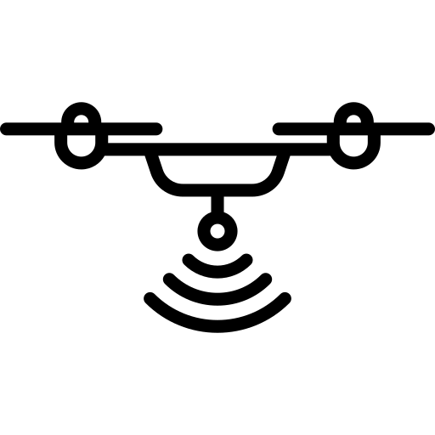
Results: Full Meadow Prediction (730 m²)
Knautia arvensis 8308 8059 - 3 %
Lotus Corniculatus 51139 50365* - 2 %
Leucanthemum vulgare 10778 7044 - 35 %
Onobrychis viciifolia 3761 595 - 84 %

Slide 21
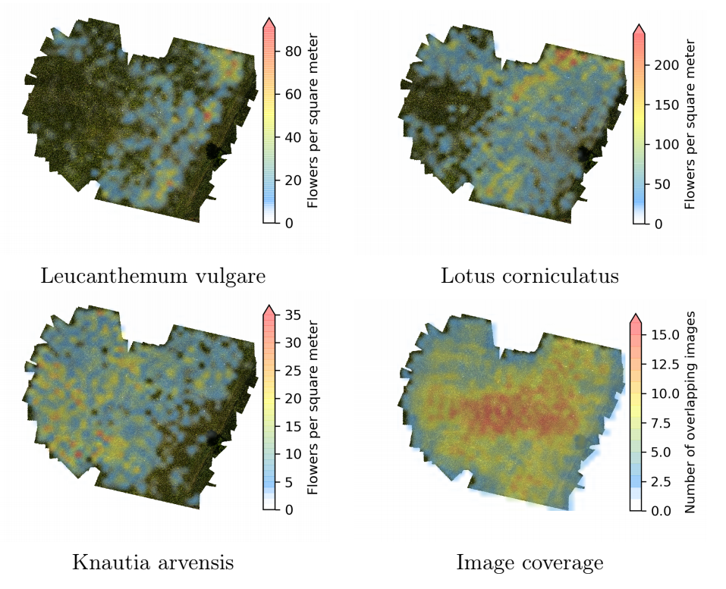
Results: Heatmaps

Slide 22
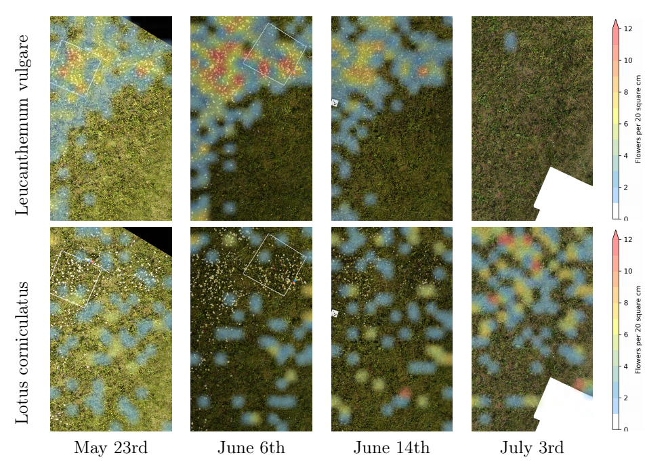
Results: Time Series

Slide 23
Results: Overlapping Images
Notes:
An additional question of the thesis is: Does the additional information from overlapping images help. So the drones take highly overlapping images such that each point in the field should be visible on 5 images. So I will evaluate if this additional information helps to improve the performance.

Slide 24
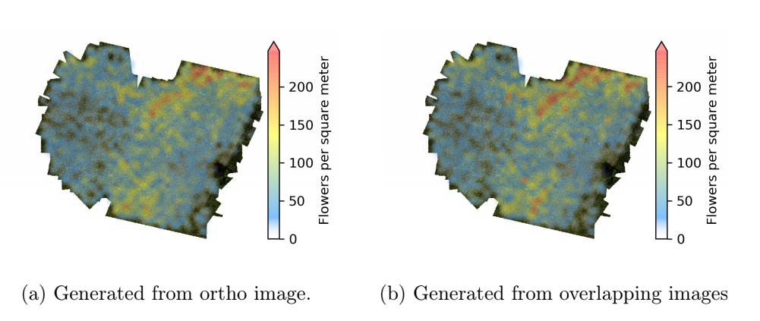
Results: Overlapping Images

Slide 25
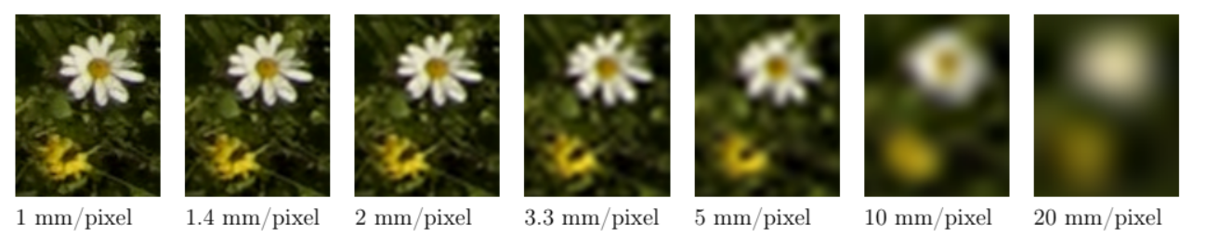
Results: Ground Resolution

Slide 26
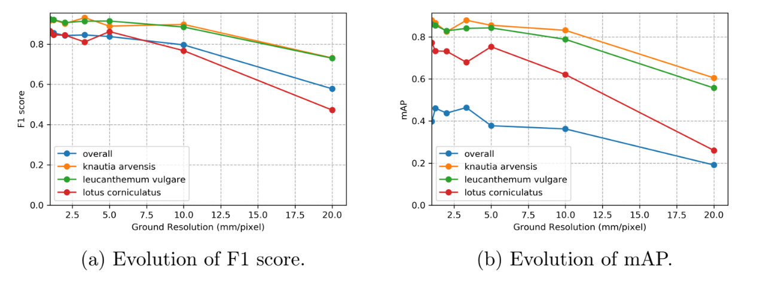
Results: Ground Resolution

Slide 27
Discussion
Effect of Ground Resolution
Point annotations vs Bounding Box annotations
Other imaginable use cases
a) Weed control (Precision Agriculture) b) Neophyte detection c) Soil properties
Neural Net Optimizations:
a) 2x Scaling b) Data augmentation c) Leveraging Overlapping Images
Scalability
Highly Reusable Suite of Tools:
PhenoAnnotator App available in Google Playstore
Command Line Interface including Usage Instructions available on Github: https://github.com/tschutli/Phenotator-Toolbox

Slide 28
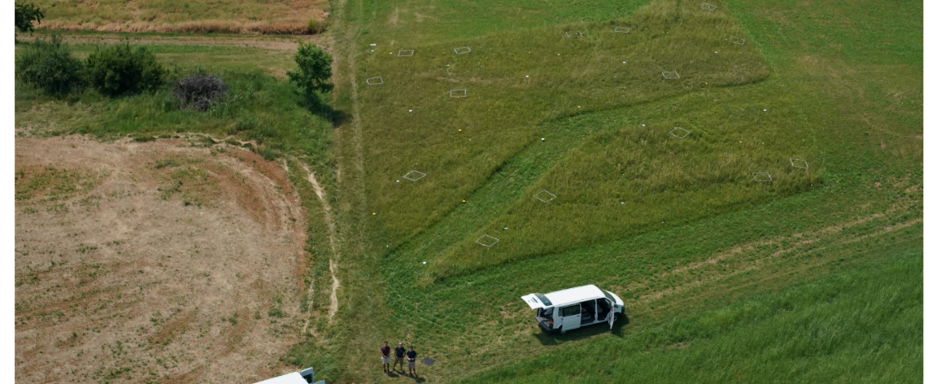
Questions?

